Slide 1
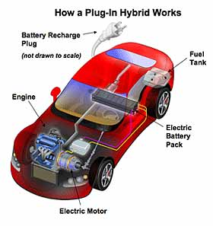
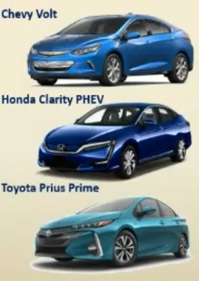
PHEV: PLUG- IN Hybrid electric vehicle
BEV
EREV
How does it work?
Battery
Charged
using
Electricity
electricity
accessed
through
plug
PEV
Battery
Charged
using
Electricity
Battery
Charged
using
Electricity
Battery
Charged
using
Electricity

Slide 2
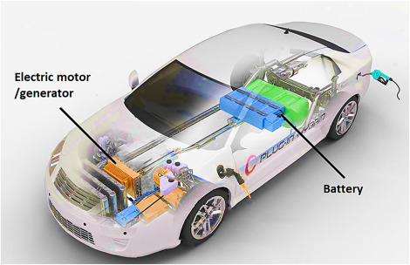
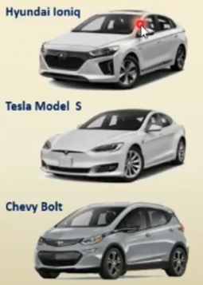
What about a “regular” hybrid?
How does it work?
Hybrid
relies on
Gasoline to
power Internal
Combustion
Engine
Electric Motor
increases
fuel efficiency
and decreases
emissions
Drive using
Electric Motor
at low speeds
and while
cruising
Battery
Automatically
Recharges while
Driving

Slide 3
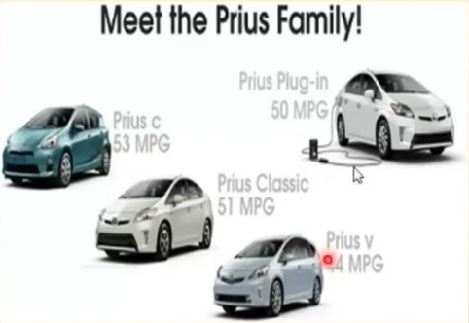
Toyota prius
First introduced in 1997 and worldwide in 2000
First mass produced hybrid vehicle
In 2011, Toyota expanded the Prius family to include the Prius V
1.5 million Prius' on the road today
Four types of Prius'
Classic Prius
Prius V
Prius C
Prius V

Slide 4

Tesla
Founded on July 2003 in San Carlos, California
Named after Nikola Tesla
Invented the Tesla Roadster in 2008
First electric sports car
Known for their luxury sedans
Current CEO: Elon Musk
CEO of SpaceX

Slide 5
Tesla model S - 2012
Powertraea:
Model S is a rear wheel drive electric vehicle. The liquid-cooled powertrain includes the battery,
motor,
drive inverter, and gear box. Microprocessor controlled, 60 kWh lithium-ion battery (230 miles range,
It is
300 miles with 85 kWh), Three phase four pole induction motor with copper rotor (310 kW, 600 ),
Inverter with variable frequency drive and regenerative braking system , and Single speed fixed gear
with
9.73:1 reduction ratio.
Charging:
10 kW capable on-board charger with the following input compatibility: 85-265 V, 45-65 Hz, 1-40 A
(Optional 20 kW capable Twin Chargers increase input compatibility to 80 A)
Peak charger efficiency of 92%
10 kW capable Universal Mobile Connector with 110 V, 240 V, and J1772 adapters

Slide 6
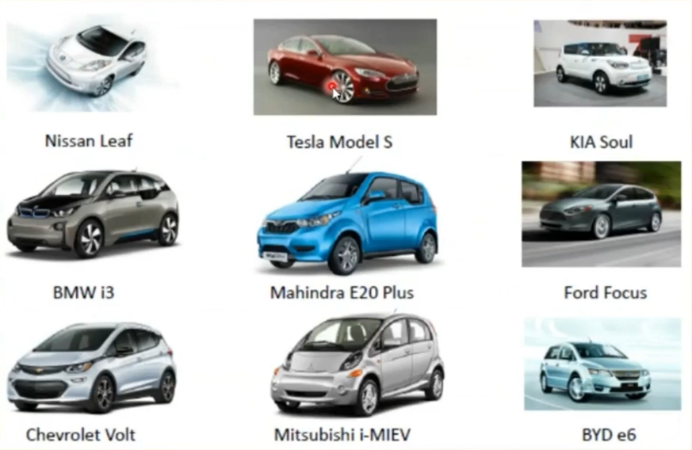
Examples of EV

Slide 7
Conventional charging (16 AMPS )
Approximately 8 hours to fully charge
Uses the same electric intensity and voltage of a house, i.E., 16 amps and 230 volts.
Usually has a power of 2,4kw and 10 amps.
Every hour that the vehicle is plugged in is equivalent to 15km of autonomy
Suitable for home charging.

Slide 8
Semi – fast charging (32 AMPS)
Needs only 4 hours to fully charge.
Uses 32 amps and 230 vac (volts alternating current)
Electric power of approximately 7.5 kw to 22 kw
Each charging hour is equivalent to an autonomy of between 40 and 120km (depending on whether you charge at 7.5kw or 22kw)

Slide 9
Fast charging
Needs only about 30 minutes to charge 80% of its battery. When using a
higher electric intensity, fast charging delivers energy in direct current.
Obtains an output power of about 50 kW.
Special infrastructure requirement
A solution to increase electric vehicles' range
every twenty minutes of charging are equivalent to 120km of autonomy approximately

Slide 10
AC: it offers the charging to 43kW in three phase. If we have a 40kWh battery capacity, we will have the 80% charged in 45 minutes, which is equivalent to 213km.
DC: it offers the charging to 50kW. If we have a 40kWh battery capacity, we will have the 80% charged in 38 minutes, which is also equivalent to 213km.

Slide 11



Connector types for EV

Slide 12
Thank You

